Slide 1
Table 1. Anthocyanin content (μg/g) in mulberries from the two varieties, Da 10 (black) and Baisang (white), at different developmental stages, S1 (10 days post-anthesis, DPA), S2 (19 DPA), and S3 (28 DPA).
Sample | Delphinidin | Cyanidin | Pelargonidin | Peonidin | Malvidin
Da 10-S1 | 0.00 | 0.00 | 0.00 | 0.00 | 0.00
Da 10-S2 | 0.00 | 23.533 ± 3.371 | 4.197 ± 0.566 | 0.00 | 0.00
Da 10-S3 | 0.00 | 375.29 ± 2.851 | 24.423 ± 1.188 | 0.00 | 0.00
Baisang-S1 | 0.00 | 0.00 | 0.00 | 0.00 | 0.00
Baisang-S2 | 0.00 | 4.87 ± 0.896 | 0.00 | 0.00 | 0.00
Baisang-S3 | 0.00 | 10.957 ± 1.381 | 0.00 | 0.00 | 0.00

Slide 2
Table 2. Core genes related to anthocyanin biosynthesis in mulberry fruit.
Pathway | Gene_ID | Gene | Enzyme | KO_ID | Gene expression level in Da10 | Gene expression level in Baisang
Phenylalanine, tyrosine and tryptophan biosynthesis | M020959 | CM | Chorismate mutase | KO00400 | + | -
 | M016616 | PAT | Bifunctional aspartate aminotransferase and glutamate/aspartate-prephenate aminotransferase |  | + | -
 | M008978 | PDT | Arogenate dehydratase/prephenate dehydratase 6 |  | + | -
Phenylpropanoid biosynthesis | M013052 | PAL | Phenylalanine ammonia-lyase | KO00940 | + | -
 | M024369 |  | Phenylalanine ammonia-lyase 1 |  | + | -
 | M024371 |  | Phenylalanine ammonia-lyase |  | + | -
 | M024372 |  | Phenylalanine ammonia-lyase |  | + | -
 | M024373 |  | Phenylalanine ammonia-lyase |  | + | -
 | M019687 | 4CL | 4-coumarate-CoA ligase 2 |  | + | -
 | M018794 | CYP | Trans-cinnamate 4-monooxygenase |  | + | -
Flavonoid biosynthesis | M017929 | CHS | Chalcone synthase | KO00941 | + | -
 | M017930 |  | Chalcone synthase |  | + | -
 | M017264 | CHI | Chalcone-flavonone isomerase |  | + | -
 | M004711 | F3'H | Flavonoid 3'-monooxygenase |  | + | -
 | M026680 | F3H | Naringenin,2-oxoglutarate 3-dioxygenase |  | + | -
 | M026681 |  | Naringenin,2-oxoglutarate 3-dioxygenase |  | + | -
 | M000974 | DFR | Bifunctional dihydroflavonol 4-reductase/flavanone 4-reductase |  | + | -
 | M023151 | ANS | Leucoanthocyanidin dioxygenase |  | + | -
 | M013110 | FLS | Flavonol synthase/flavanone 3-hydroxylase
 | M013110 | FLS | Flavonol synthase/flavanone 3-hydroxylase |  | - | +
Anthocyanin biosynthesis | M019697 | UFGT | Anthocyanidin 3-O-glucosyltransferase 2 | KO00942 | + | -
 | M016781 | UGAT | Cyanidin-3-O-glucoside 2-O-glucuronosyltransferase |  | + | -
+, indicates up regulation of gene. - indicates down regulation of gene.

Slide 3
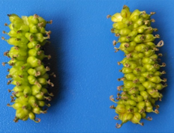
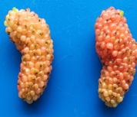
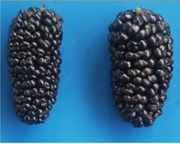
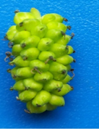
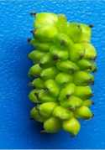
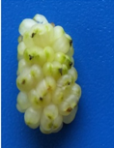
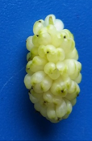
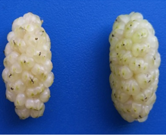
S1
S2
S3
S1
S2
S3
Figure 1. Mulberry variety, Da10 (up) and Baisang (down) fruit at different developmental stage 10d (S1), 19d (S2) and 28d (S3) after anthesis.

Slide 4
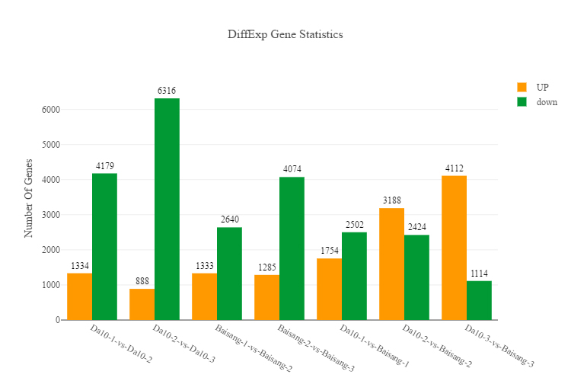
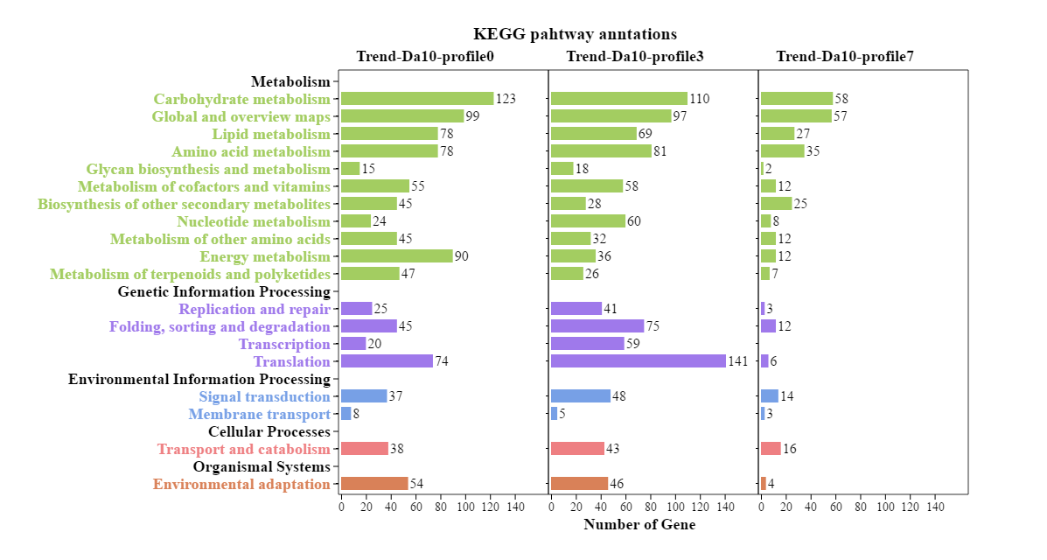
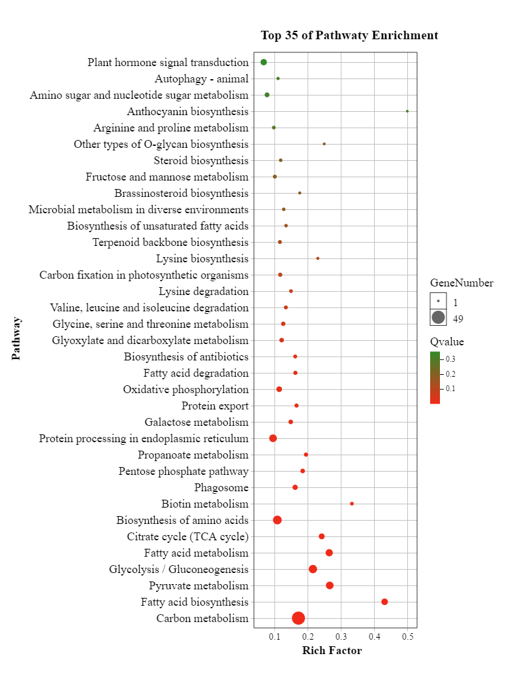
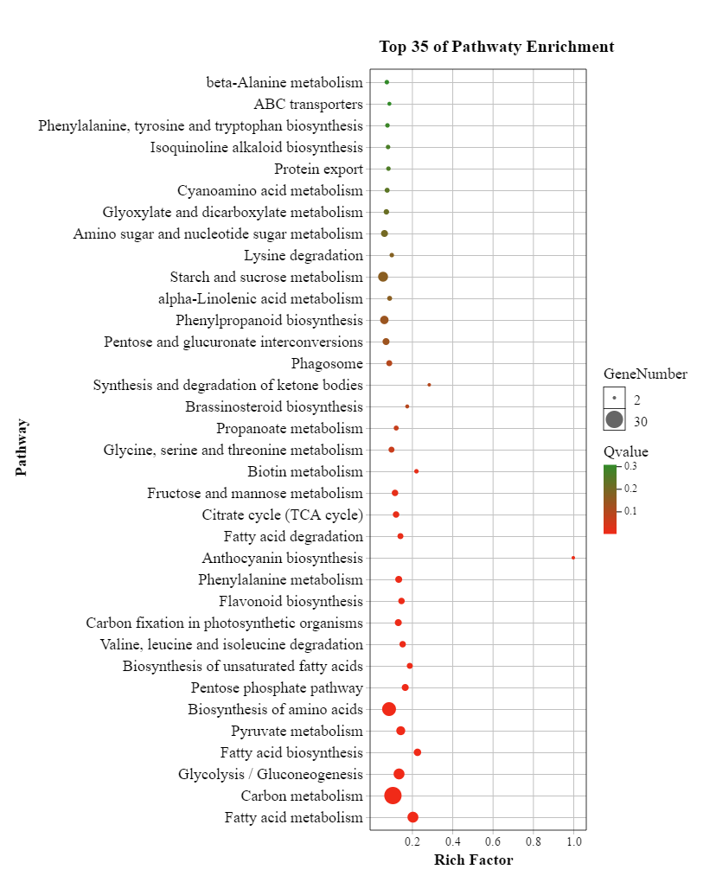
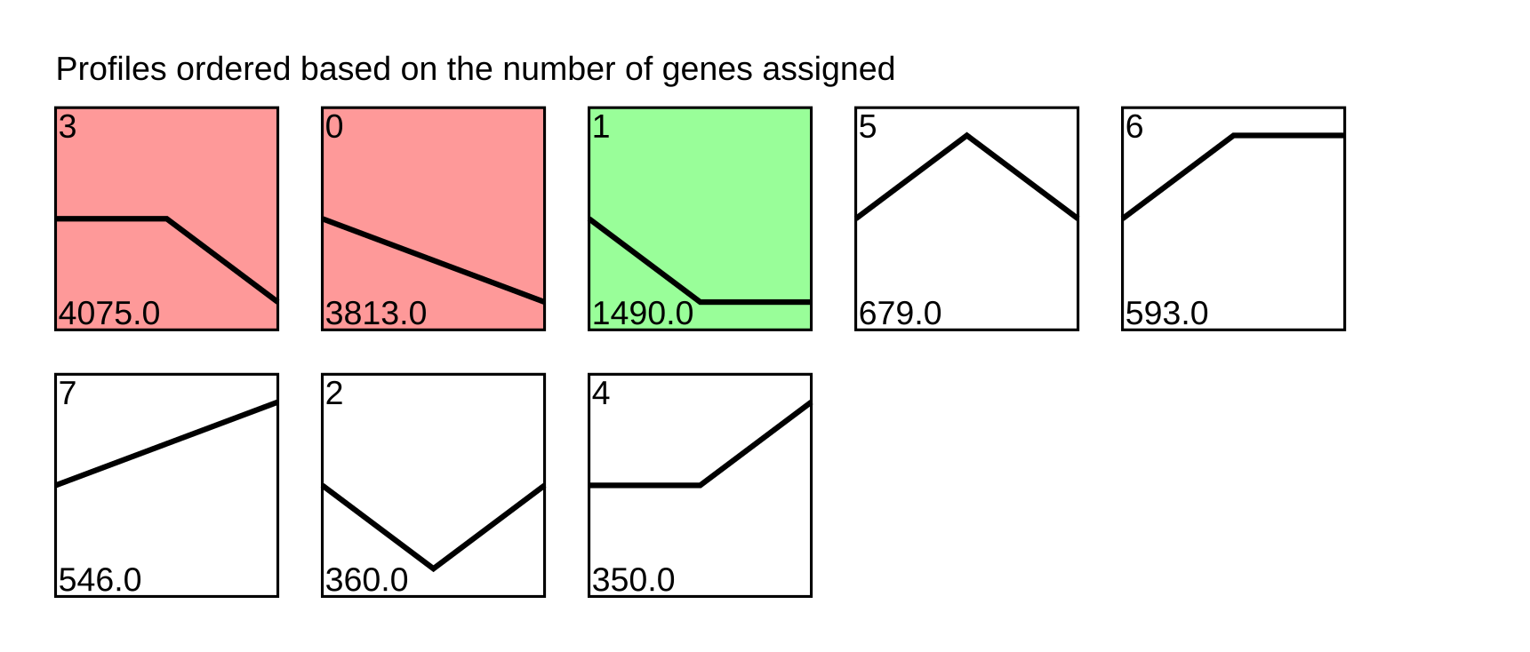
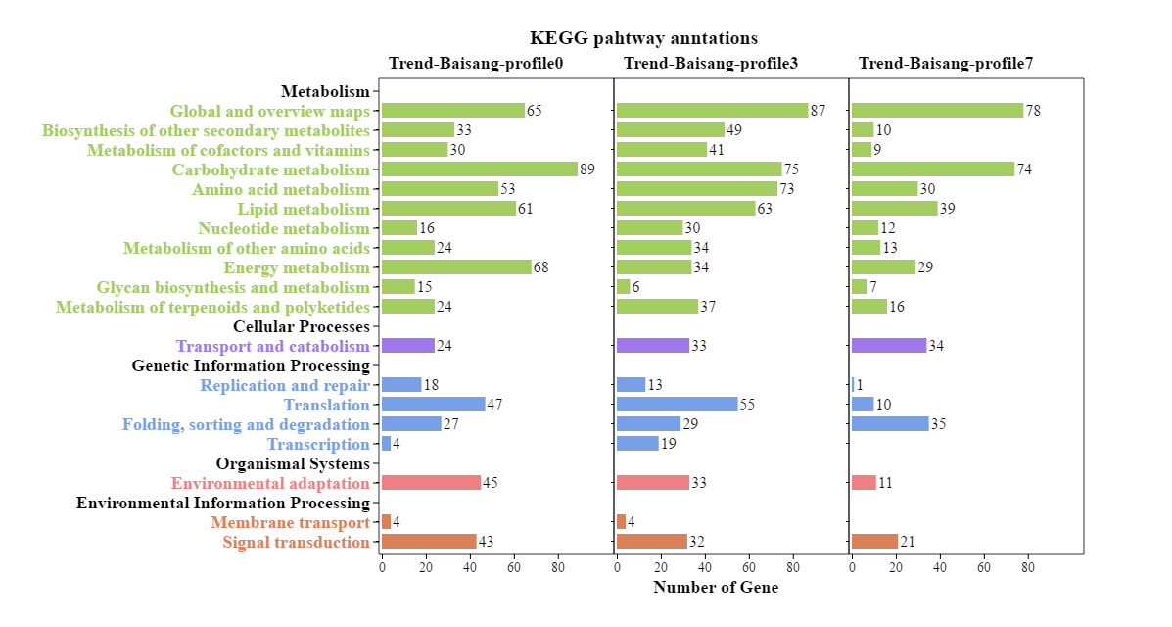
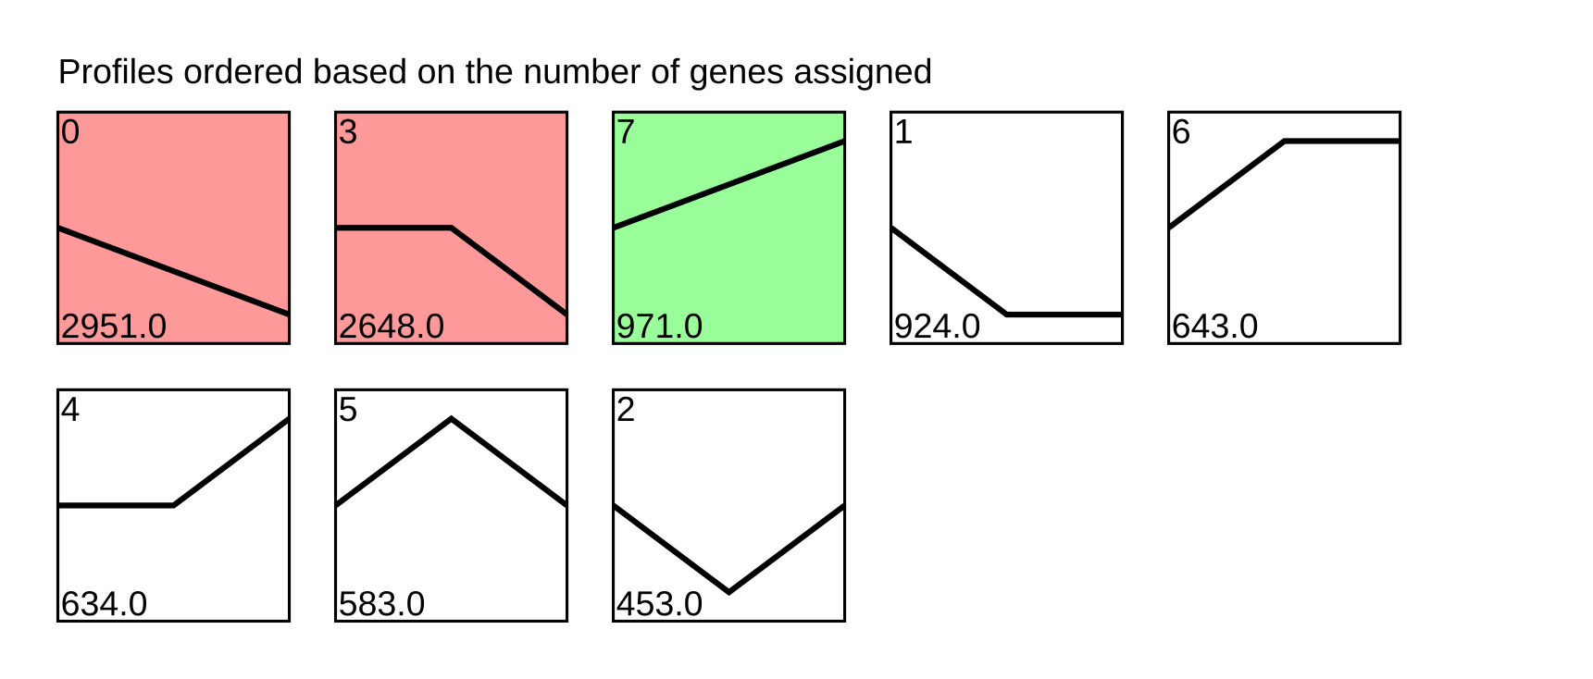
A
C
D
B
Figure 2. Patterns of gene expression and KEGG enrichment of two mulberry genotypes at three stages.
(A) DEGs analysis of two mulberry genotypes. (B) STEM analysis of gene expression patterns in Da10 (up) and Baisang (down). (C) KEGG annotation of Da10 (up) and Baisang (down) at the three stages. (D) Pathway enrichment analysis of profile7 in Da10 (left) and Baisang (right).

Slide 5
Naringenin chalcone
Leucopelargonidin
Pelargonidin
Epiafzelechin
bHLH (M026077)
bHLH (M022662)
MYB (M011278)
ANS
ANR
CHS
CHI
DFR
UFGT
(M017929)
(M017930)
(M017264)
(M026680)
(M026681)
(M000974)
(M019697)
Naringenin
F3H
P-Coumaroyl-CoA
Dihydrokaempferol
Pelargonidin 3-O-glucoside
F3'H
F3'H
(M004711)
FLS
CYP
4CL
(M018794)
(M019687)
Eriodictyol
Kaempferol
Cinnamoyl-CoA
P-Coumaric acid
F3H
Dihydroquercetin
DFR
Leucocyanidin
F3'5'H
4CL
CYP
(M003442)
F3'H
FLS
ANS
(M019687)
(M018794)
Dihydrotricetin
Cinnamic acid
F3H
Quercetin
Cyanidin
(M013052) (M024369) (M024371) (M024372) (M024373)
(M026680)
(M026681)
F3'5'H
ANR
PAL
UFGT
Dihydromyricetin
Myricetin
Epicatechin
(M013110)
Phenylalanine
DFR
FLS
PDT
(M000974)
Chrysanthemin
(M008978) (M018050)
Leucodelphinidin
MYB (M011278)
ADT
UGAT
L-Arogenate
ANS
(M023151)
(M016781)
PAT
MYB (M022975)
Delphinidin
ANR
(M014834)
(M016616)
Epigallocatechin
Cyanidin 3-O-glucoside
Prephenate
CM
UFGT
MYB (M019093)
(M019697)
(M020959)
Chorismic acid
Malvidin 3-O-glucoside
Figure 3. Schematic representation of anthocyanins biosynthetic pathway in mulberry fruit.

Slide 6

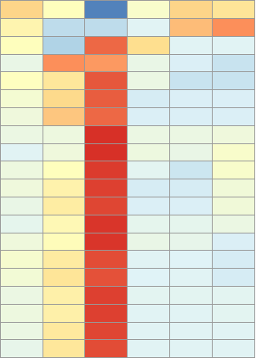
Da 10
Baisang
S1
S2
S3
S1
S2
S3
MYB (M011278)
FLS (M013110)
PDT (M008978)
PAT (M016616)
PAL (M024372)
UFGT (M019697)
MYB (M022975)
UGAT (M016781)
bHLH (M026077)
bHLH (M022662)
CHI (M017264)
MYB (M019093)
CHS (M017929)
CM (M020959)
CYP (M018794)
4CL (M019687)
F3’H (M004711)
F3H (M026681)
DFR (M000974)
ANS (M023151)
Figure 4. Expression level of 15 core genes and 5 transcription factors in anthocyanins biosynthetic pathway of mulberry fruit.
Color indicates the gene expression level from higher expression (red) to lower expression (blue). Color square indicates Da10 and Biasang varieties at developmental stage S1, S2 and S3.

Slide 7
Figure 5. Expression validation of core genes and transcription factors by qPCR

Slide 8
Table S1. Transcriptome sequence numbers of mapped reads from the two mulberry genotypes at three stages.
Sample |  | No. of Reads (×10⁶) | Unique Mapped Reads (×10⁶) | No. of Mapped Reads (×10⁶) | Mapping Ratio (%) | All Gene Number
Da10-1 | Da10-1-1 | 38.72 | 25.78(66.59%) | 26.57 | 68.62% | 19080
 | Da10-1-2 | 42.24 | 27.93(66.12%) | 28.77 | 68.12% | 19138
 | Da10-1-3 | 41.28 | 27.51(66.65%) | 28.35 | 68.68% | 19061
Da10-2 | Da10-2-1 | 44.82 | 29.44(65.68%) | 30.41 | 67.87% | 18194
 | Da10-2-2 | 55.87 | 36.19(64.78%) | 37.43 | 67.01% | 18389
 | Da10-2-3 | 43.51 | 28.53(65.59%) | 29.49 | 67.80% | 18099
Da10-3 | Da10-3-1 | 50.06 | 32.42(64.77%) | 33.74 | 67.41% | 17156
 | Da10-3-2 | 41.68 | 26.88(64.48%) | 27.99 | 67.17% | 16806
 | Da10-3-3 | 44.98 | 29.21(64.96%) | 30.42 | 67.64% | 16848
Baisang-1 | Baisang-1-1 | 41.54 | 26.85(64.65%) | 27.74 | 66.78% | 18950
 | Baisang-1-2 | 34.58 | 22.55(65.22%) | 23.29 | 67.36% | 18924
 | Baisang-1-3 | 39.77 | 25.84(64.98%) | 26.68 | 67.10% | 18940
Baisang-2 | Baisang-2-1 | 33.97 | 22.03(64.86%) | 22.72 | 66.90% | 18433
 | Baisang-2-2 | 36.28 | 23.35(64.37%) | 24.07 | 66.35% | 18388
 | Baisang-2-3 | 37.50 | 24.20(64.52%) | 24.94 | 66.51% | 18378
Baisang-3 | Baisang-3-1 | 41.97 | 27.45(65.41%) | 28.25 | 67.31% | 17457
 | Baisang-3-2 | 73.93 | 47.43(64.16%) | 48.81 | 66.03% | 18367
 | Baisang-3-3 | 33.52 | 21.80(65.02%) | 22.41 | 66.88% | 17438

Slide 9
Table S2. Primers used for qRT-PCR
Gene_ID |  | Sequence (5'--3')
Morus010170 | F | AGGGCGGATTGAGGAAAGGA
 | R | GCTGACGAAAGGGAAGTAAGG
CM-Morus020959 | F | CGCTTCAAATCCAAGACCCAC
 | R | TCATCCGTCCTATCCTTCGTC
PAT-Morus016616 | F | CGTCGCTTGTCTCGGTTTC
 | R | GCCGTGGCTTGGTCAGTTA
PDT-Morus008978 | F | ACCGCTAATCCAGCCGAAG
 | R | CCGATGCCGTTTGGGAAG
PAL-Morus024372 | F | AACACGAGCACCTCAATCTTC
 | R | CCCAACTCCTCCCTCACAA
4CL-Morus019687 | F | TGGCGAAGAACCCGAAGG
 | R | GCCTTGTCATCGTTCAAATACC
CYP-Morus018794 | F | CCGTCCCTTTCTTCACCAAC
 | R | GCCTCCTCAAAACGATGCC
CHS-Morus017929 | F | GCGTGTGTAGTGTTCATTTTGG
 | R | CGAGTCCTTCTCCTGTGGTCT
CHI-Morus017264 | F | CGGTAAGTGGAAGGGGAAGT
 | R | GTGGGCGATTGTGTGAAGAG
F3’H-Morus004711 | F | TGAAATCAACGGCTACCACA
 | R | TCATACCCGCACAAATCCTAC
F3H-Morus026681 | F | TCCCAAAACTCTCACGGCTC
 | R | GGAAGATACCCCAGTCCTCAC
DFR-Morus000974 | F | CTGTAAAGATGACTGGATGGATGT
 | R | AATCACGAGCGTTGGAATAATAG
ANS-Morus023151 | F | GGCTTGCGACCACCATACTT
 | R | GTTGAGGGCATCTCGGGTAG
FLS-Morus013110 | F | TCCCTCTCGCATCAACTACC
 | R | CTGAACACCTTATCCGCCAC
UFGT-Morus019697 | F | AGACGGGGAGGGAGGTTAG
 | R | TGAGCGGATAGAGAACAAGGC
bHLH-Morus022662 | F | GCGTGCCTTACAAGAACTCATAC
 | R | GGGGGAACTGAAACATAGGATAG
bHLH-Morus026077 | F | ATGGAGAGCCAACACAAGAGAG
 | R | TTGAAGCGTTTTGAGCCGT
MYB-Morus019093 | F | GCAGCAAGGTGGGGATAAAG
 | R | GGGCGAAGGTAGTTCATCCAG
MYB-Morus022975 | F | ATTACATTCACAAACACGGCGA
 | R | ACAACTTTTACCGCACCGAA
MYB-Morus011278 | F | AAGTTGAGGAGGCAGCAGAG
 | R | CTTGACCAGCCGTAGCACC

Slide 10
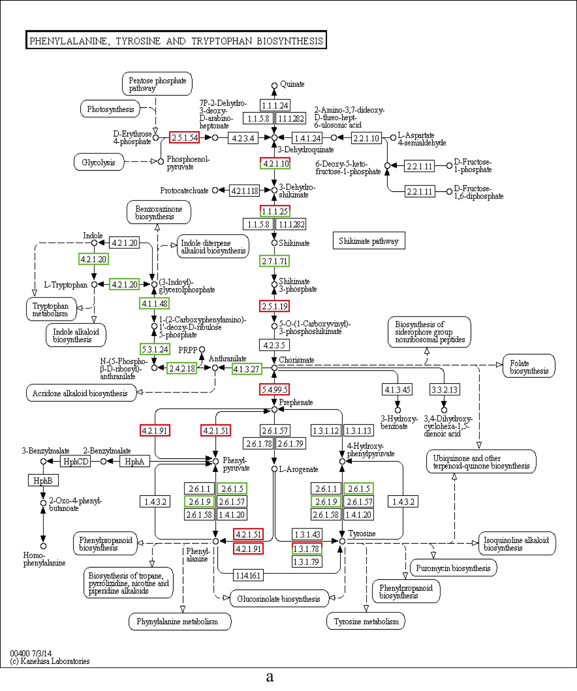
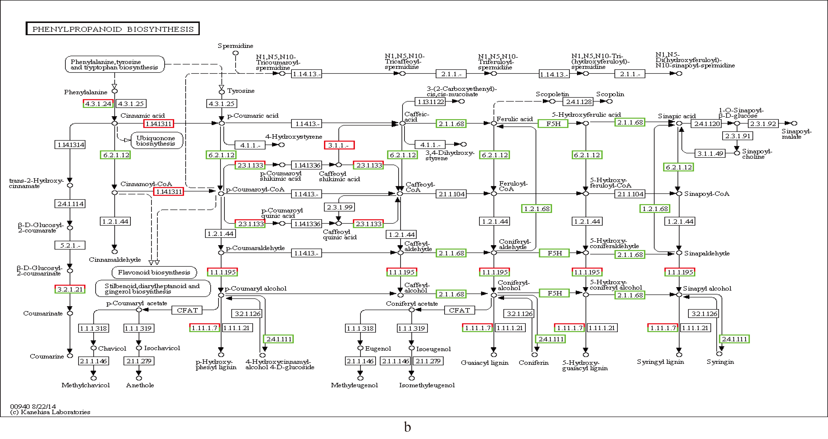
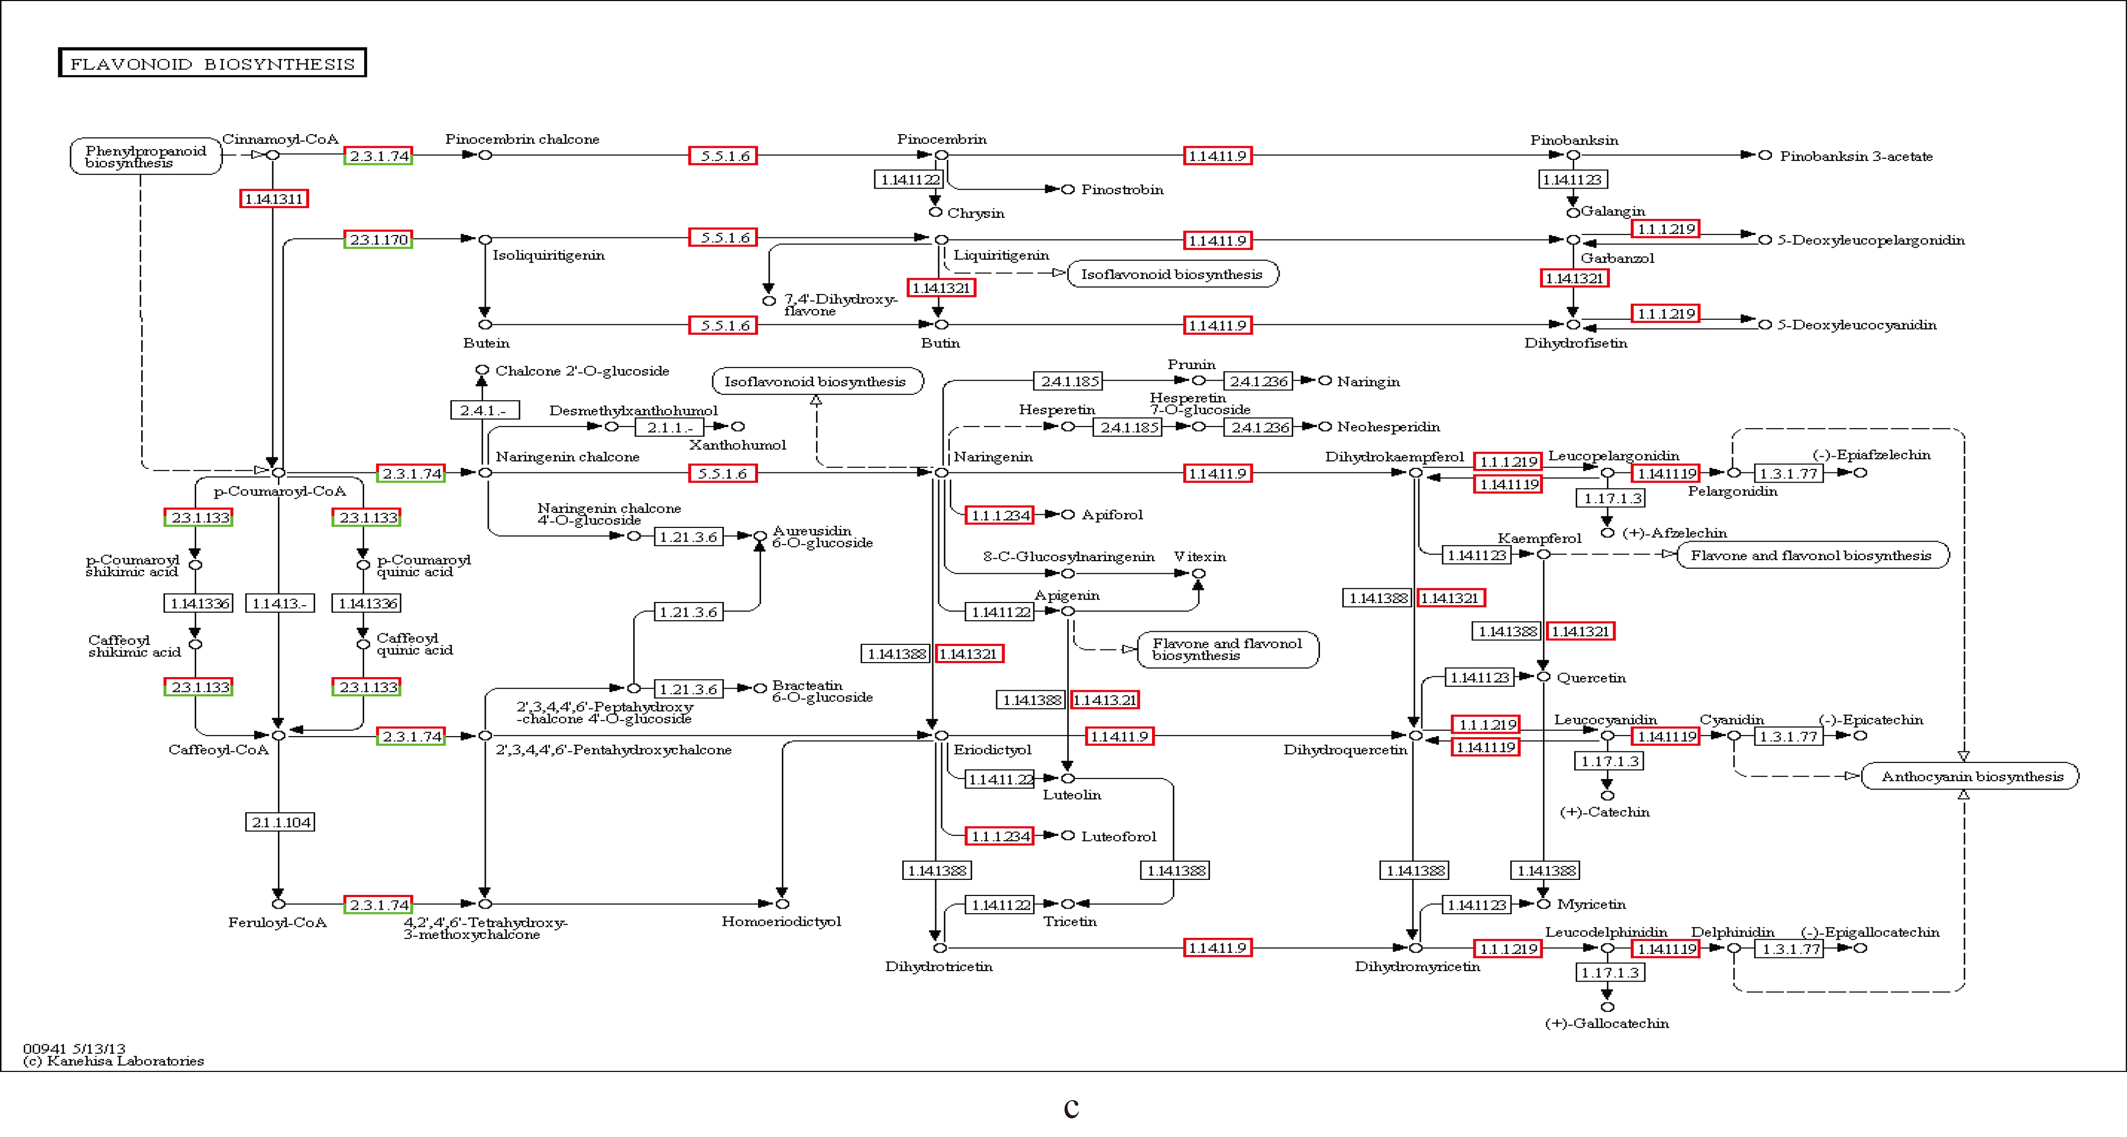
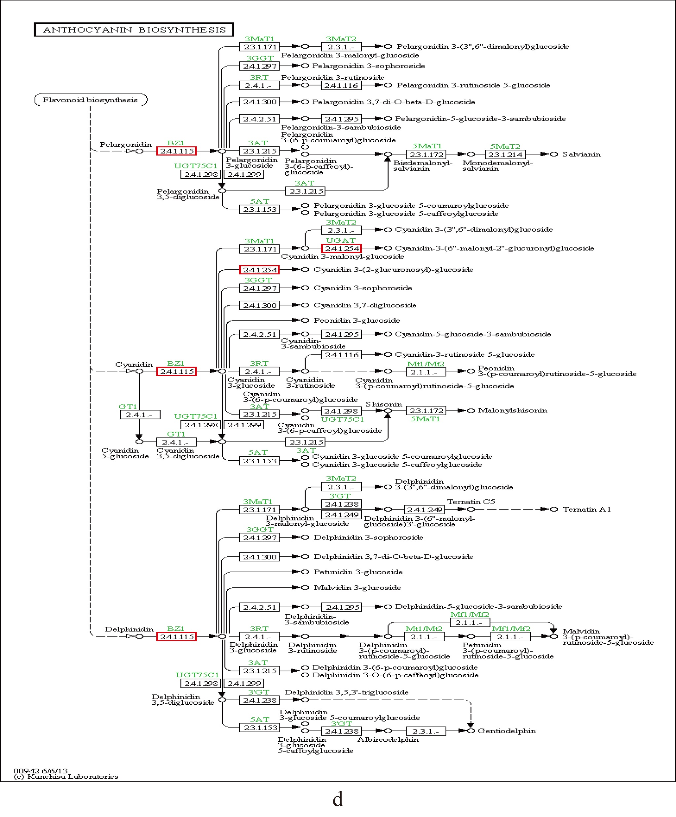
Figure S1. Biosynthesis pathway in mulberry fruit.
a. Phenylalanine, tyrosine and tryptophan biosynthesis.
b. Phenylpropanoid biosynthesis.
c. Flavonoid biosynthesis.
d. Anthocyanin biosynthesis.

